Slide 1

FLEXTRADE SHOPPING APP EXCEL CAPSTONE PROJECT
PRESENTED BY: TOYIN REBECCA OYEWOLE
SUBMITTED ON: 15 SEPTEMBER 2024

Slide 2

BACKGROUND
FlexTrade is a globalised company in the online shopping space.
For a very long time, they have improved and eased the process of shopping. They offer a wide range of products, including clothing and electronics.
Their app is designed to be easy to use, hoping to make shopping fun and simple for all its users.
To maintain their lead in the competitive online retail space, FlexTrade intends to continuously enhance their software. This project will investigate ways to improve the user experience of their app.

Slide 3


BUSINESS PROBLEM
Even though lots of people download and use the FlexTrade app, not everyone ends up buying something. There are a few problems:
High Bounce Rate: Many users leave the app quickly without buying anything.
Cart Abandonment: Users put items in their cart but don't complete the purchase.
Low Average Order Value: The amount of money users spend is lower than what FlexTrade would like.
Lots of Competition: There are many other shopping apps out there, so FlexTrade needs to stand out

Slide 4

Aim of Project
AIM OF PROJECT
The goals are to:
Find UX Problems: Look at how users behave and what they say to find out what needs to be better.
Make Checkout Better: Make it easier and quicker for users to buy things.
Suggest Personalized Products: Use what we know about what users like to suggest other things they might buy.
Get Users to Buy More: Figure out ways to encourage users to spend more money.

Slide 5
OVERVIEW OF KEY METRICS
Average of Bounce Rate
49%
Average of Conversion Rate
50%
Total Cart Addition
2,586 of 5,425
Average of Session Duration
15 Minutes
A 49% average bounce rate indicates that 49% of website or app visitors leave after viewing one page or taking no further action.
A 50% average conversion rate signifies that half of users who visit your website or app complete a desired action
A 48% total cart addition rate indicates nearly half of users are interested enough to add items to their cart, which shows a healthy level of engagement.
An average session duration of 15 minutes indicate that, on average, users spend 15 minutes per session on the website or app before leaving.

Slide 6

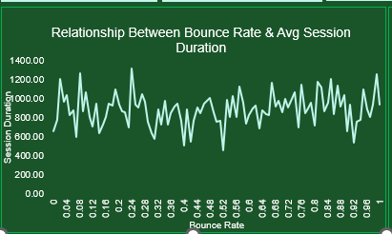
VISUALS
Insight:
From the analysis no clear correlation between bounce rate and session duration. This suggests that even when users stay on the app or website longer, it doesn’t necessarily reduce the likelihood of them bouncing (leaving the app without taking any meaningful action).
Other factors may be contributing more significantly to the bounce rate than session duration.
Recommendation:
Focus on improving the quality of engagement. Identify which features, content, or products users are interacting with during their sessions and optimize those to reduce bounce rates.
Segment User Behaviour: Look into segmenting the data further to identify patterns that may explain why some users bounce quickly while others spend more time.

Slide 7
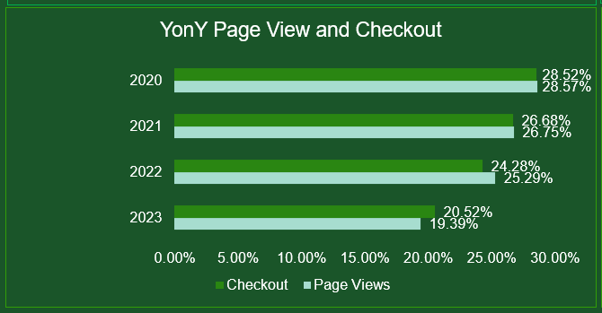
VISUALS
Insight:
There is a declining trend in both page views and checkouts over the years, with page views dropping from 28.57% in 2020 to 19.39% in 2023 and checkouts decreasing similarly. . This could be caused by outdated website design, poor user experience, lack of targeted marketing.
Recommendation:
Conduct User Research: Analyse user behaviour using tools like Google Analytics or heatmaps to identify drop-off points in the customer journey.
Optimize Marketing: Implement personalized email campaigns, social media ads, and SEO strategies to attract new customers and re-engage existing ones.
Improve UX/UI: Update the website design, improve mobile responsiveness, and simplify the checkout process..

Slide 8
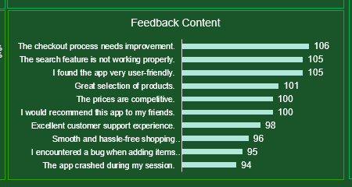
VISUALS
Insight:
Check out process: Feedback indicates a need for improvement in the checkout process, despite the app's user-friendliness.
Search Functionality Issues: Issues with the search feature are also causing friction, potentially leading to cart abandonment or low conversion rates.
Recommendation:
Optimize Checkout Process: The analysis suggests optimizing the checkout process by simplifying steps, making payment and shipping options intuitive, and implementing features like guest checkout and transparent pricing.
Improve Search Functionality: Enhancing search functionality through audits, filters, sorting options, and search analytics can improve user experience and prioritize frequently searched items.

Slide 9
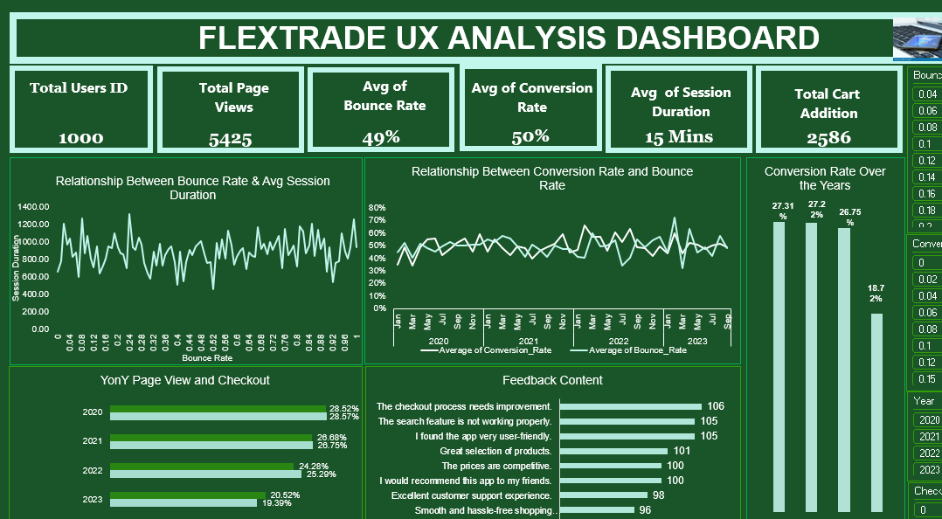

Slide 10
KEY TAKEAWAYS FROM RECOMMENDATIONS
Optimize user interaction features, content, or products to enhance engagement and reduce bounce rates, focusing on understanding which elements keep users engaged for a more engaging user experience.
Consider testing new strategies to improve engagement, like replicating the strategies used in period of high users’ engagement (Feb 2022 e.g., promotional offers or targeted marketing), this will help boost conversions and retain users.
To reverse a decline trend in page and checkouts, consider conducting a comprehensive user experience audit to identify outdated features. Refreshing the app’s design, introducing new features, or implementing targeted marketing campaigns could help attract and retain users.
Prioritize technical improvements by addressing the checkout process and search feature functionality, as these are the most reported issues. Regular updates, bug fixes, and performance testing could help reduce these problems.

Slide 11


